Slide 1
MAR 580: Advanced Population Modeling for Management of Living Marine Resources
Lecture 1C
Numerical Methods 1: Differentiation, Root-finding, Optimization
(Acknowledgements: André Punt)
04 September 2025

Slide 2
Outline
Why Numerical Methods?
Overview of numerical methods for scientific computing
Taylor series approximation
Differentiation
Root-finding
Optimization

Slide 3
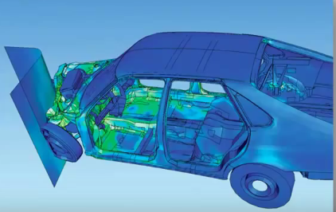
What are numerical methods?
Numerical methods develop accurate and fast approximations to problems whose exact solutions are difficult to find because of their complexity.

Slide 4
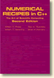
What are numerical methods?
Numerical methods develop accurate and fast approximations to problems whose exact solutions are difficult to find because of their complexity.
Much of the software we use have most common methods available via libraries.
BUT for comprehensive info check out ‘Numerical recipes’ (Press et al. 1986, 1994)
http://numerical.recipes/
http://tonic.physics.sunysb.edu/docs/num_meth.html

Slide 5
When are numerical methods used?
Main types of problems:
Differentiation
Integration
Interpolation / Extrapolation
Roots of equations
Solution of simultaneous equations
Nonlinear minimization
Matrix problems (nothing to do with Neo)
Today
Later this course
Later this course
Today
Today

Slide 6
Calculus
Differentiation
How steep is the curve at point x?
Integration
How much area is under the curve between a and b?
a
b
x

Slide 7
Taylor series approximation
“single most useful, and used, application of calculus for an ecologist” (Bolker 2009)
Approximates a complicated function near a point we care about using a simple function (e.g. 2nd order polynomial)
Useful applications:
Shapes of goodness of fit surfaces.
Delta method for estimating variance.

Slide 8
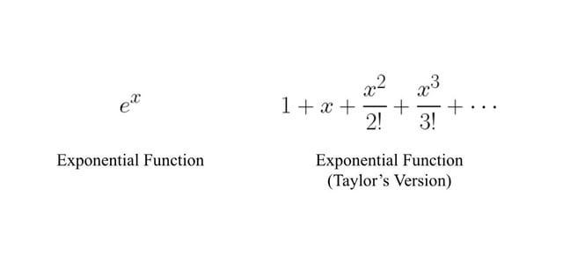
Taylor series approximation

Slide 9
Taylor series
Mathematically:
where the derivatives are evaluated at the point x₀
The approximation means dropping terms past the 2nd or 3rd. (e.g. ‘second-order Taylor approximation’…)

Slide 10
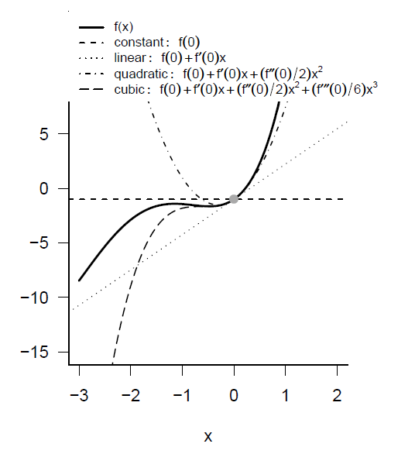
Taylor series expansion

Slide 11
Differentiation
Kinds
Symbolic
formula, like sqrt(x+3x^2)
Algorithmic
value, like 12.41
exact answer from formula
Numeric
value, like 12.37
approximate answer from numerical methods

Slide 12
Symbolic vs Numerical Differentiation
Differentiation is algorithmic - there is no function that cannot be differentiated (given patience and a large piece of paper).
Many packages (including R) include symbolic differentiation routines. These apply an algorithm to provide code which computes the derivatives analytically.
Numerical differentiation involves applying approximations to calculate the value of the derivative at a given point.

Slide 13
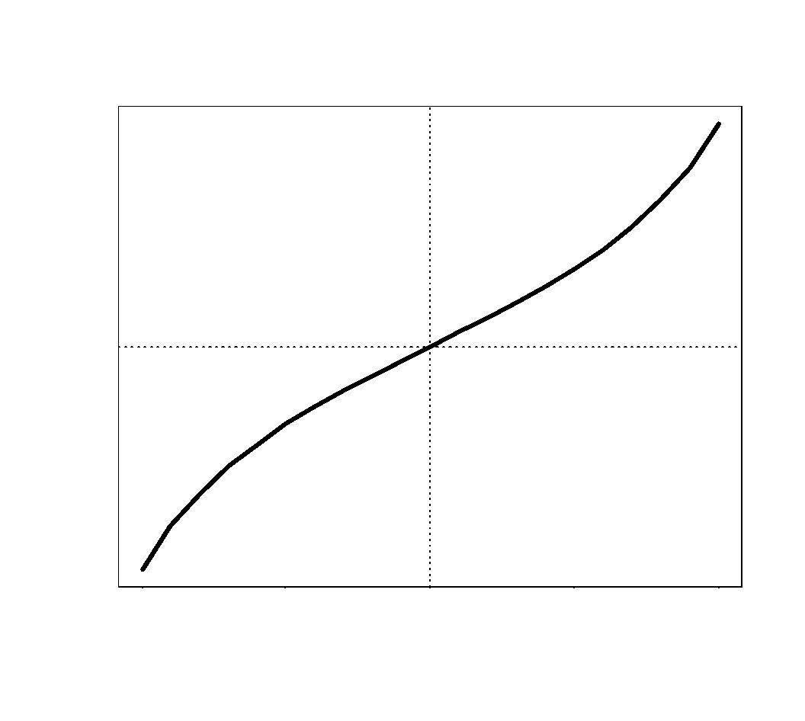
Symbolic differentiation in R
e.g. tan(x)
Pass the formula as an expression
First derivative, tan'(x)
> D(expression(tan(x)), "x")
1/cos(x)^2
Second derivative, tan''(x)
> D(D(expression(tan(x)),"x"), "x")
2 * (sin(x) * cos(x))/(cos(x)^2)^2

Slide 14
Algorithmic differentiation in R
Can define our own function, knowing that tan'(x) = 1/cos(x)^2
> dtanx.dx <- function(x)
{
gradient <- 1/cos(x)^2
return(gradient)
}
> cbind(x, dtanx.dx(x))
Another approach is to define the derivative
> dtanx.dx <- D(expression(tan(x)), "x")
and evaluate it
> eval(dtanx.dx)
The deriv function gives more information
> dtanx.dx <- deriv(expression(tan(x)),"x")
> eval(dtanx.dx)
> attr(eval(dtanx.dx),"gradient")

Slide 15
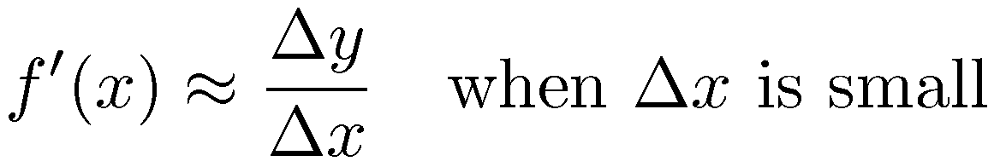
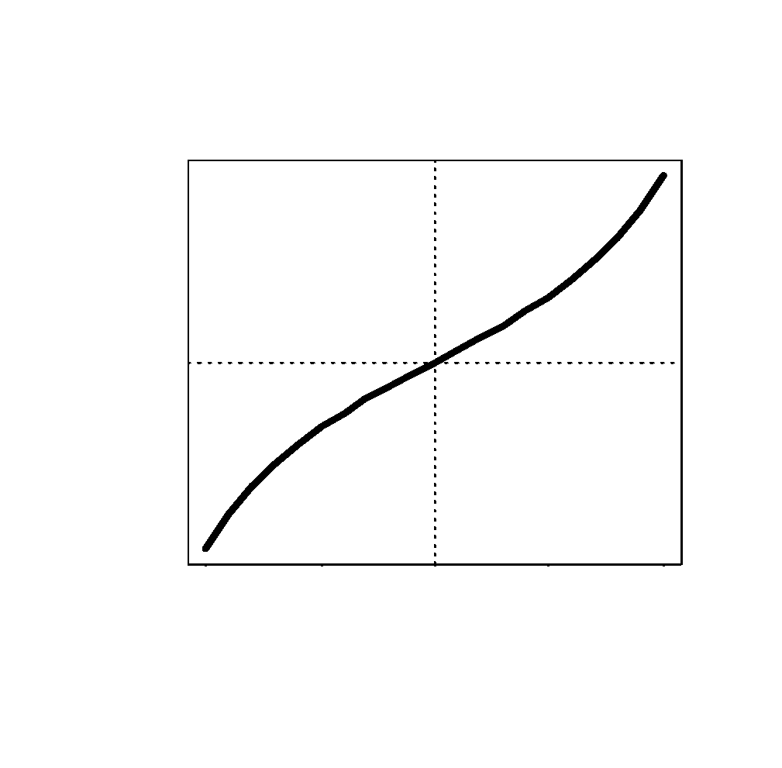
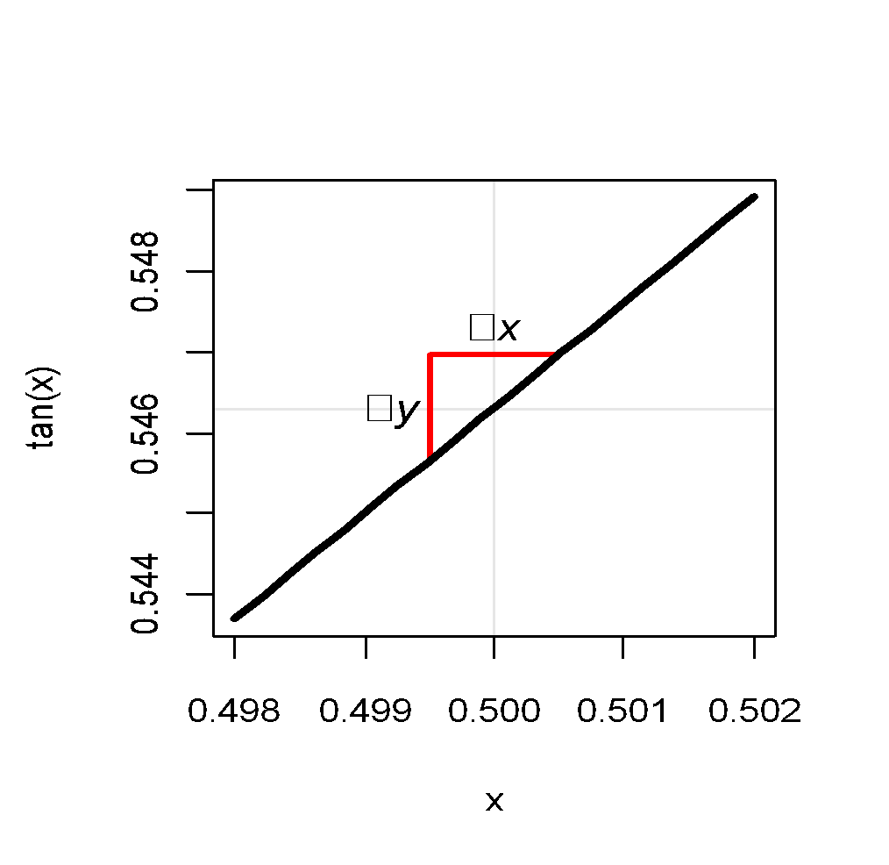
Numeric differentiation

Slide 16
Numeric differentiation
Approximate differentiation may be needed for complicated problems
> dfx.dx <- function(f, x, delta)
{
y1 <- f(x - delta/2)
y2 <- f(x + delta/2)
approx.gradient <- (y2-y1) / delta
return(approx.gradient)
}
> dfx.dx(tan, x, 0.001)

Slide 17
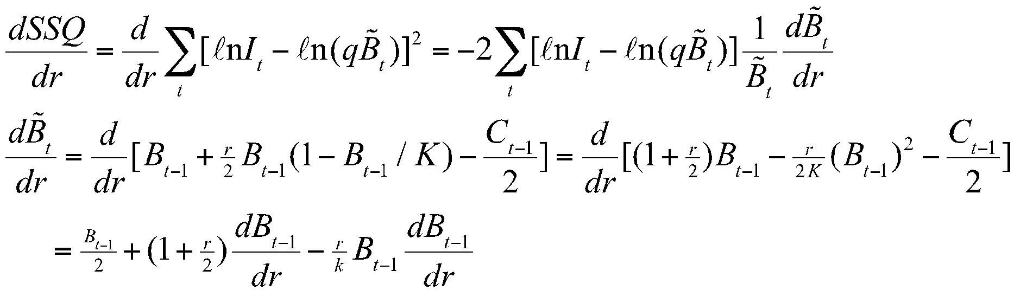
Calculating Derivatives Numerically
Sometimes calculating derivatives analytically can get rather tedious. For example, for the dynamic Schaefer model:

Slide 18
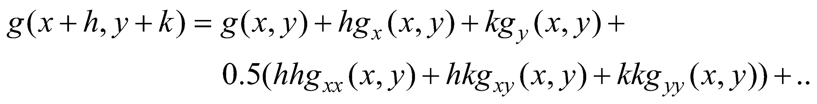
Calculating Derivatives Numerically
Methods of numerical differentiation rely on Taylor series’ approximations to functions, i.e.:

Slide 19
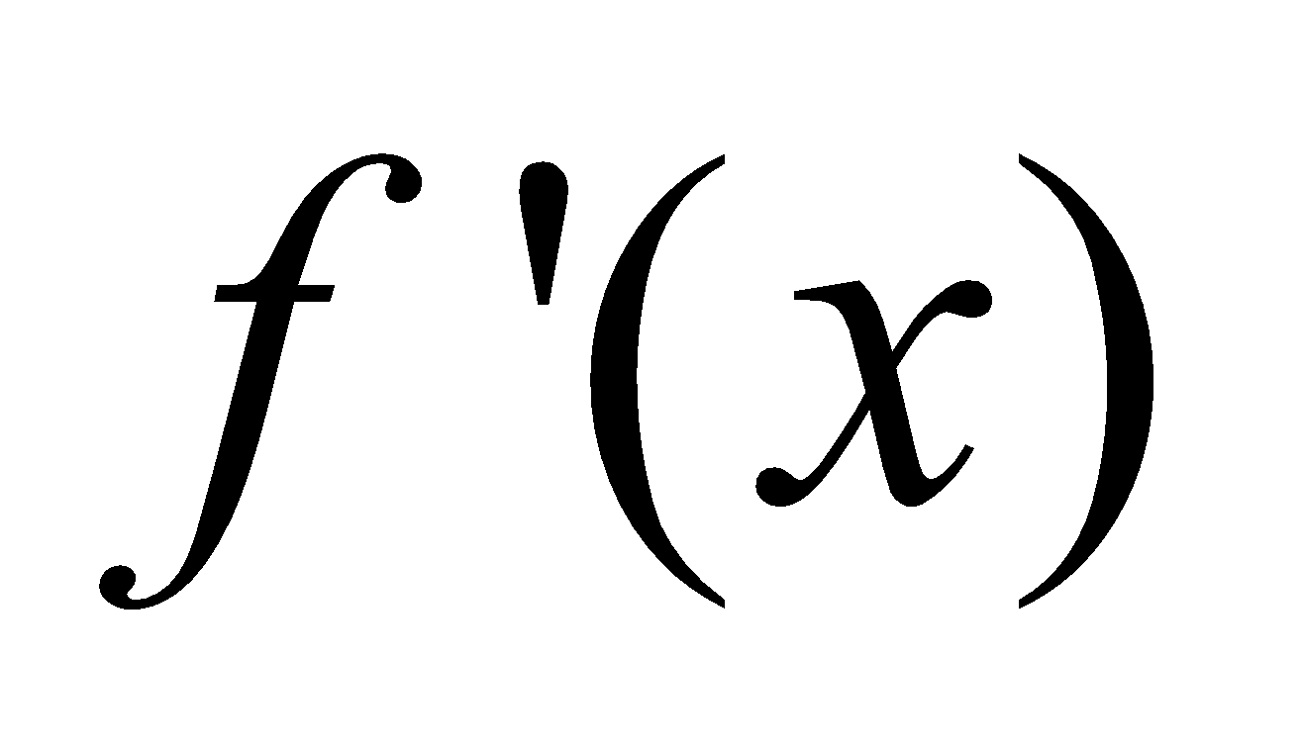
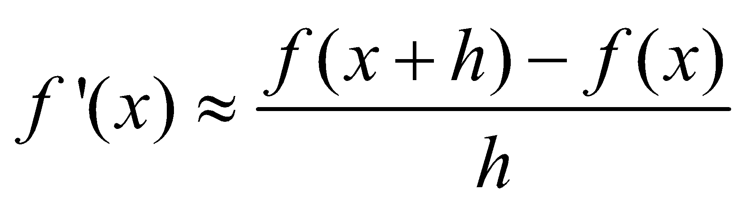
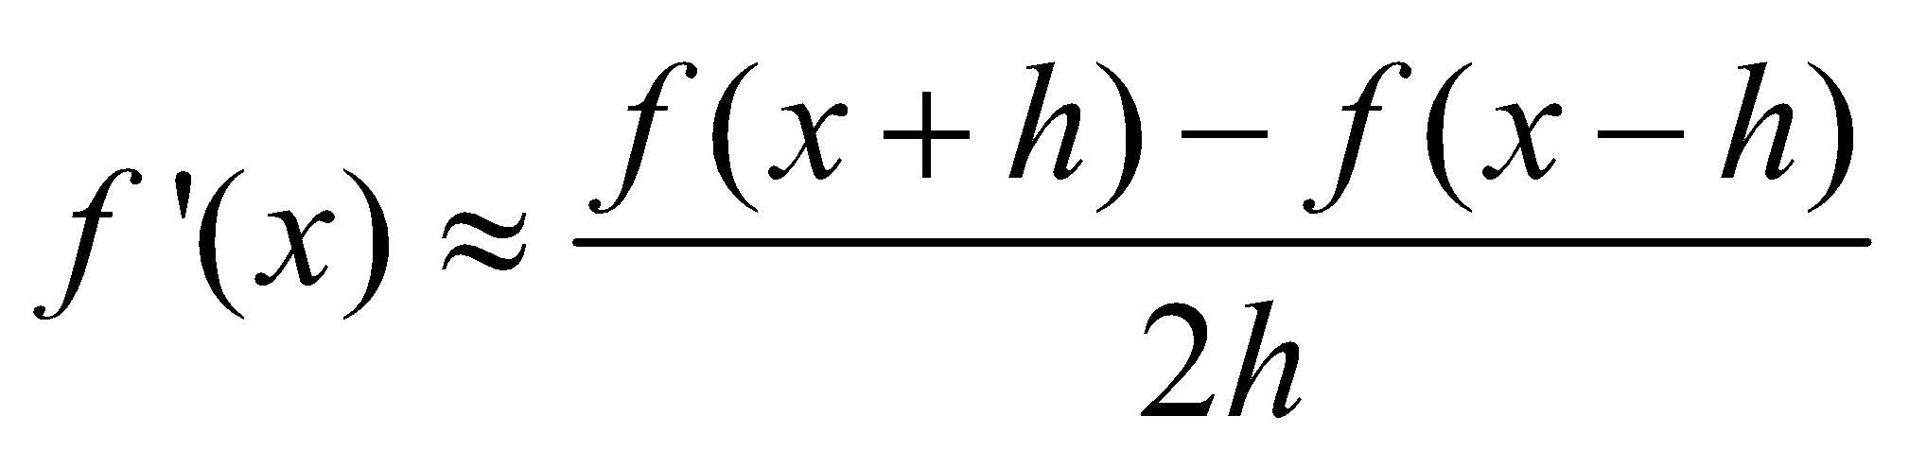
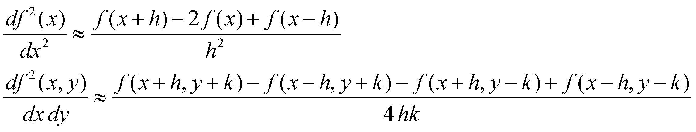
Calculating Derivatives Numerically
Method of finite differences.
Two common approximations to exist. Both rely on two function evaluations.
Approximating second derivatives:
Notes:
The accuracy of the approximation depends on the number of terms and the size of h / k (smaller – but not too small – is better)

Slide 20
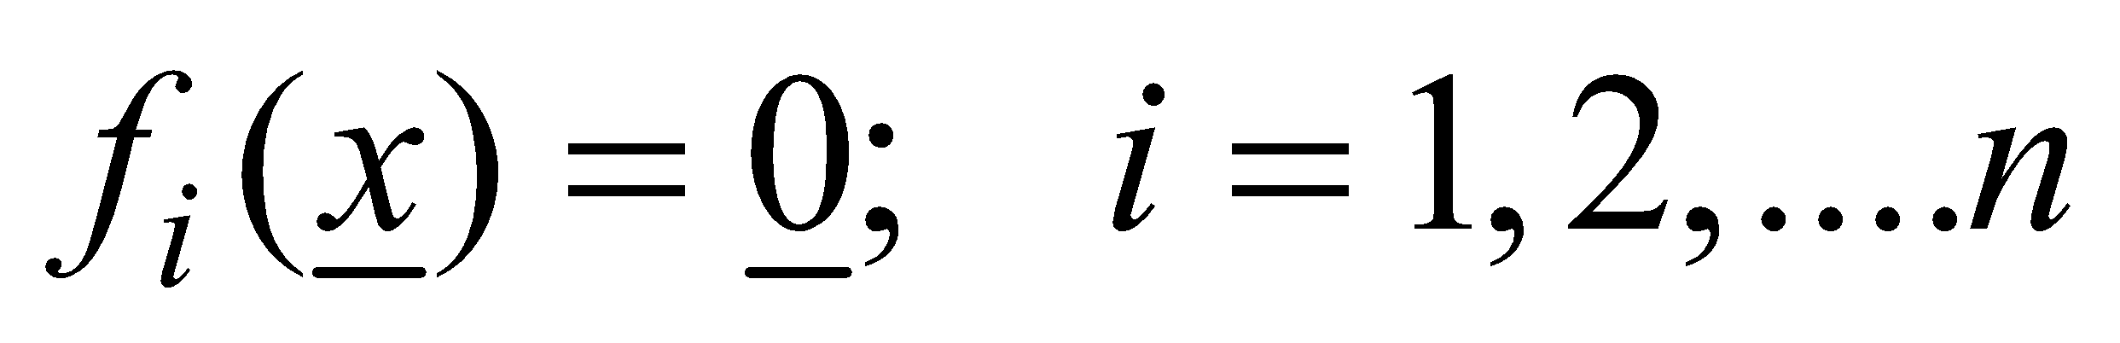
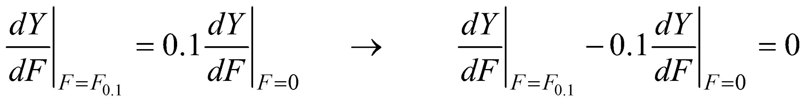
Root-finding
Find the value for x such that the following system of equations is satisfied:
General problem frequently used in stock assessment and management.
Find K for a Schaefer model so that if the Schaefer model is projected from K in year 0 to year T, the biomass in year T equals Z.
Find the catch limit so that the probability of recovery equals a pre-specified value.
Find F_{0.1} so that:
Consider case when n=1.

Slide 21
Methods for root-finding
Lots of methods. Choice among these depends on:
Cost of evaluating the function.
Is the function differentiable? (it must be continuous and monotonic for most methods).
Is the derivative of the function easily computable?
Cost of programming the algorithm.
Non-derivative based:
Bisection method (simple)
False positive method
Brent’s method (method of choice)

Slide 22
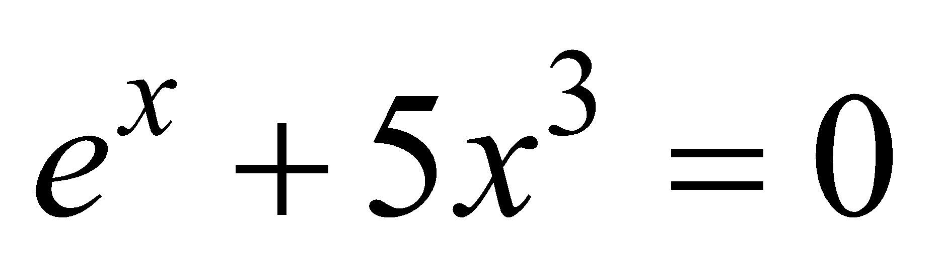
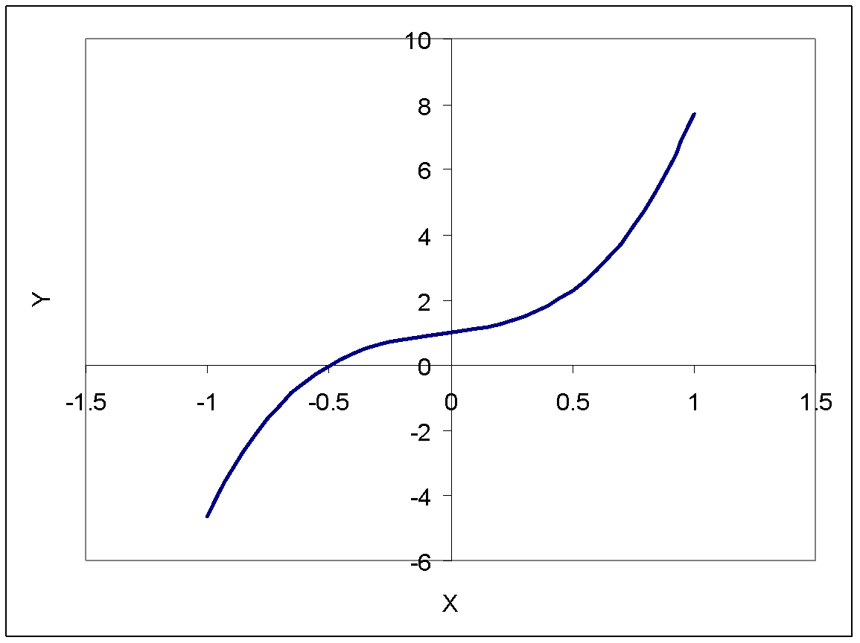
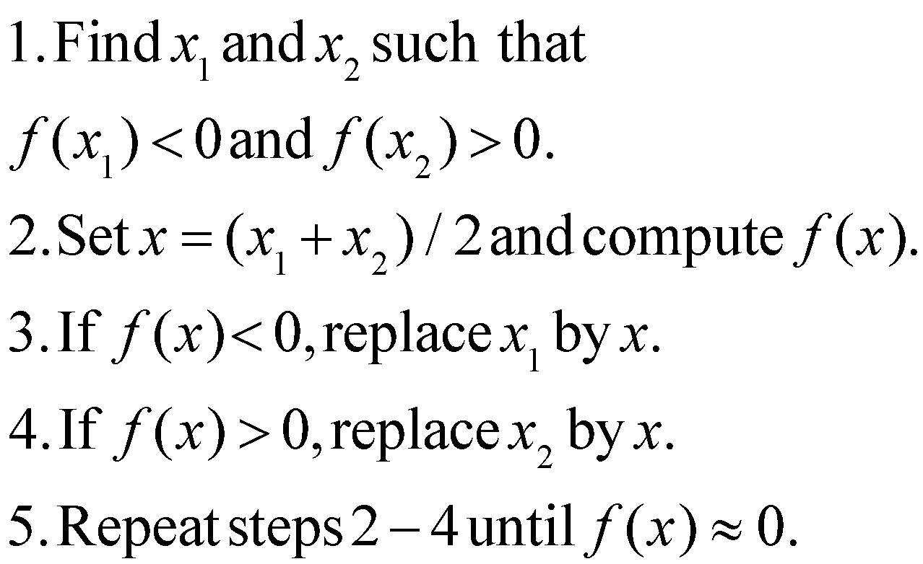
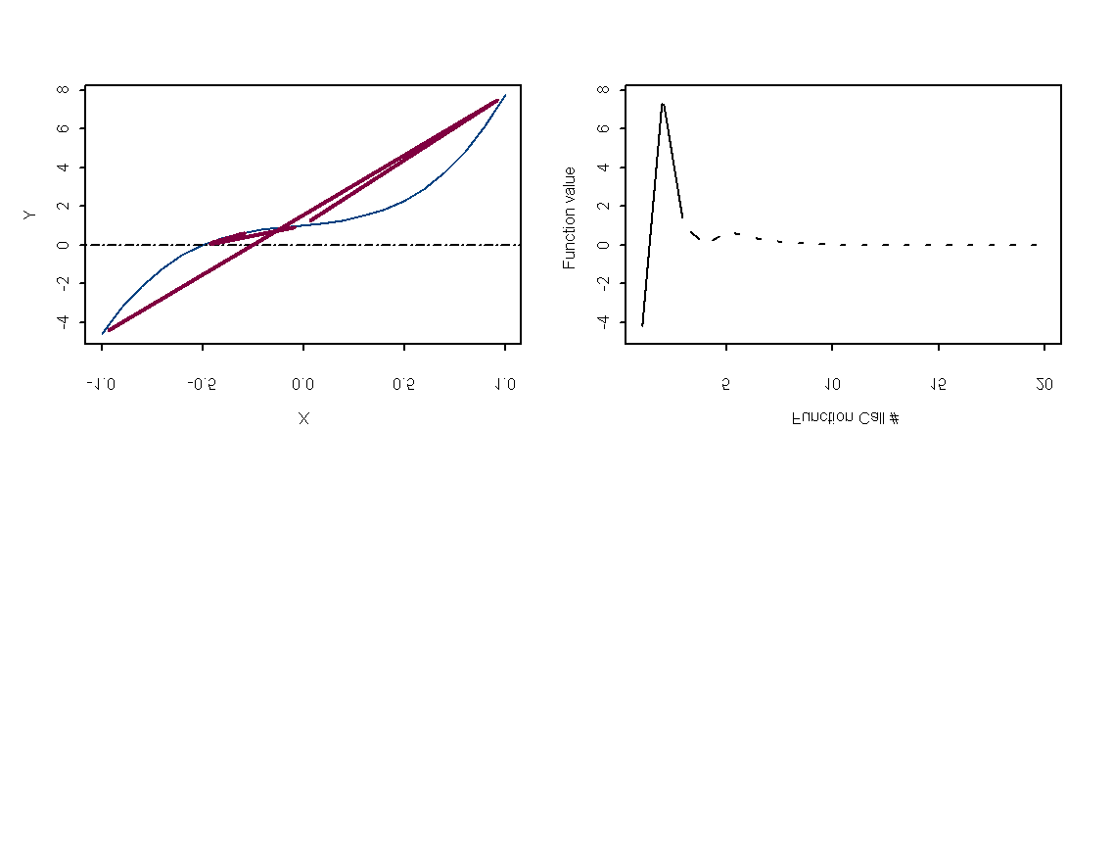
Example
Bisection:

Slide 23

Brent’s method
Brent’s method assumes quadratic behavior, i.e.:
3 function calls per iteration.
BUT: number of function calls can be much less than for the bisection & false positive methods (at the cost of a more complicated computer program).
Brent’s method underlies the R function uniroot.

Slide 24

Brent’s Method

Slide 25
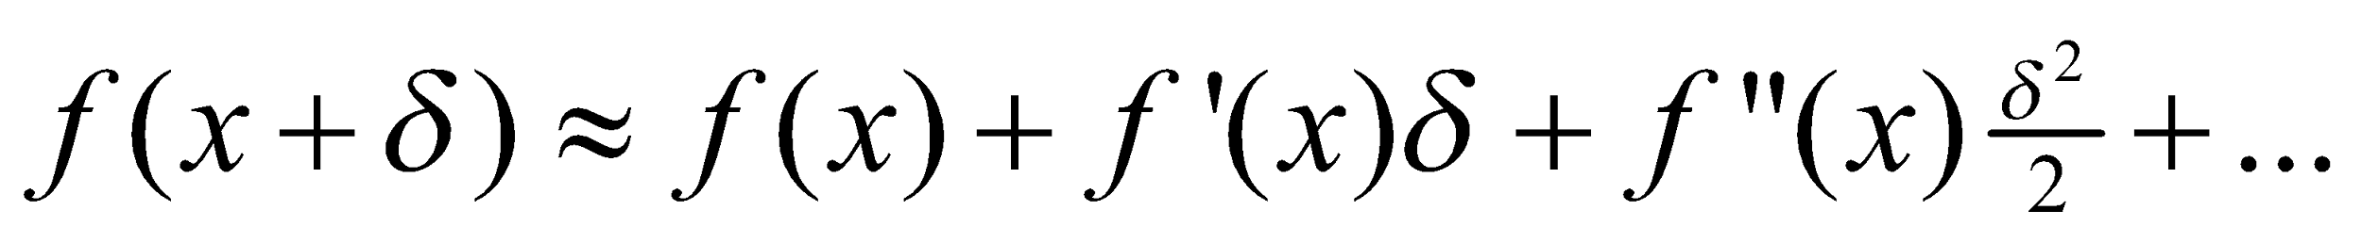
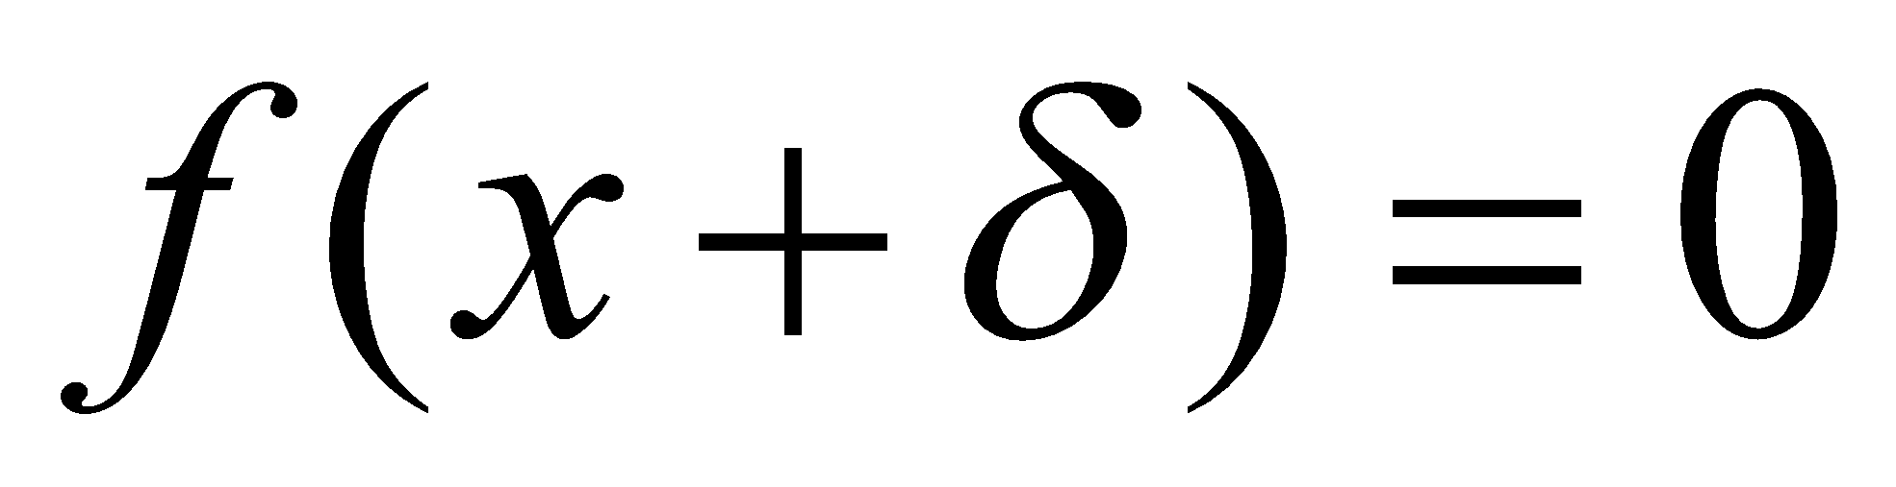
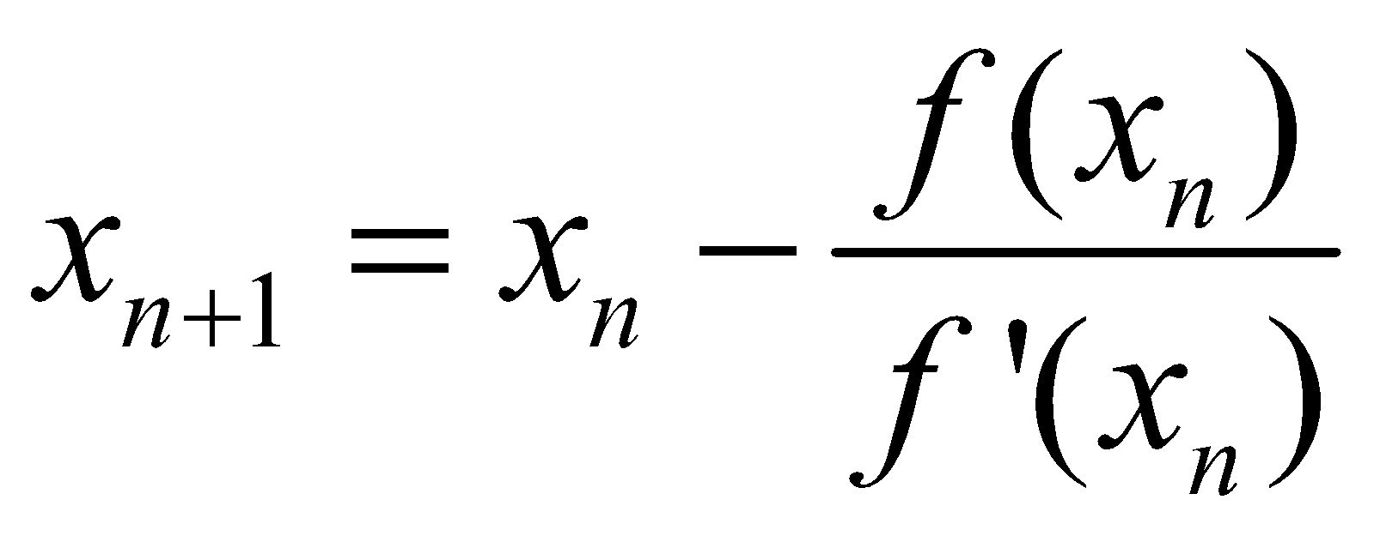
Newton’s Method (Newton-Raphson)
Derivative-based method
Taylor series expansion of the function f:
For “small” values of δ and for “well-behaved” functions we can ignore the 2nd and higher order terms. We wish to find so:
Newton’s method iteratively applies the above equation.

Slide 26
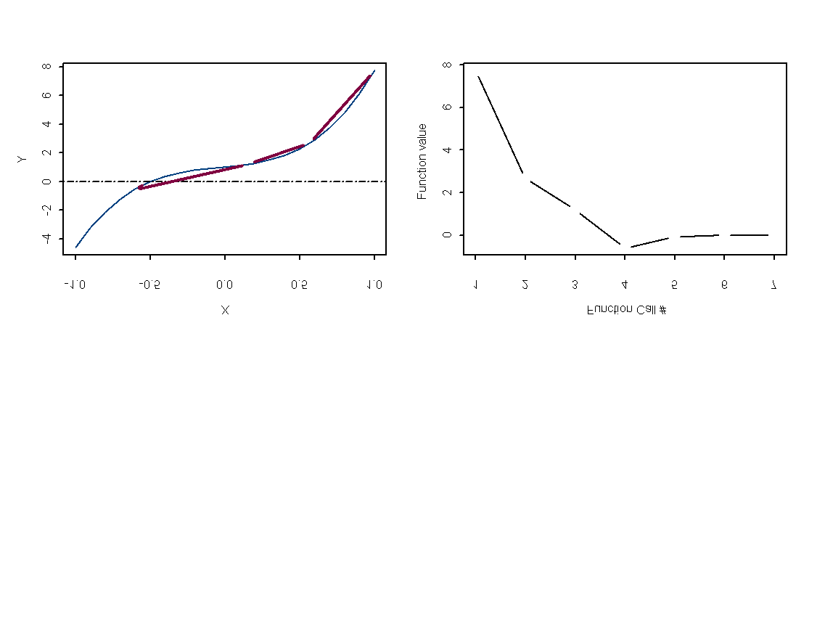
Newton’s Method
Note that Newton’s method may diverge rather than
converge. This makes it of questionable value for
general application.

Slide 27
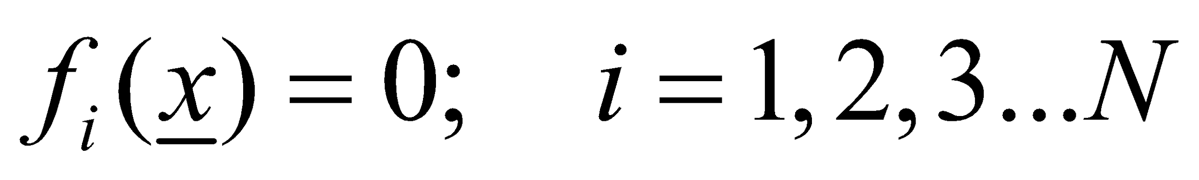
Multi-dimensional problems
Find the vector x so that:
Either: use a multiple-dimension version of the Newton-Raphson method;
Or: Treat the problem as a non-linear minimization problem.

Slide 28
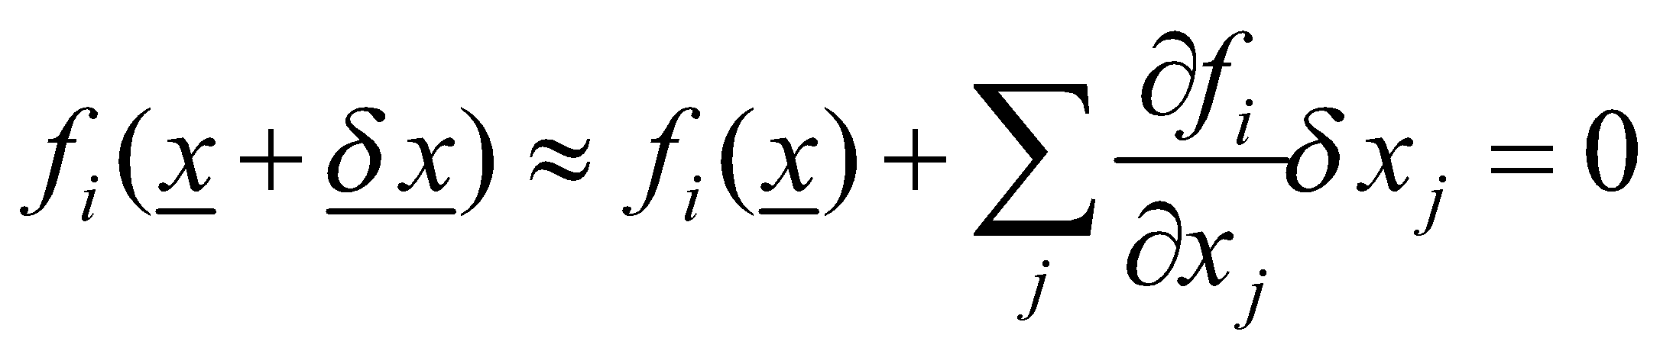
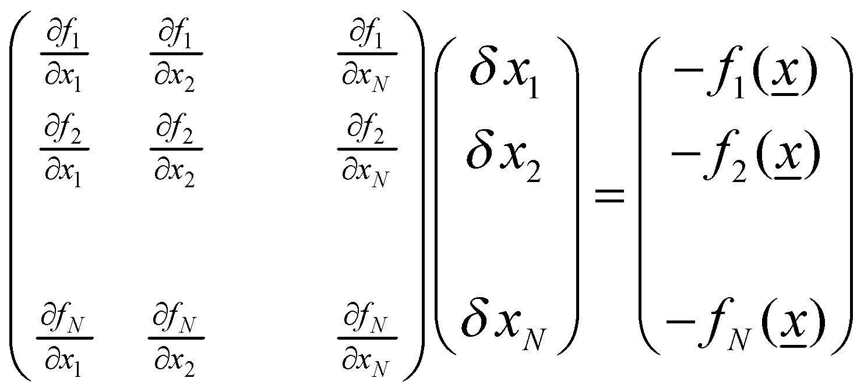
Multi-dimensional Newton-Raphson
The Taylor series expansion about x is:
This can be written as a series of linear equations:

Slide 29
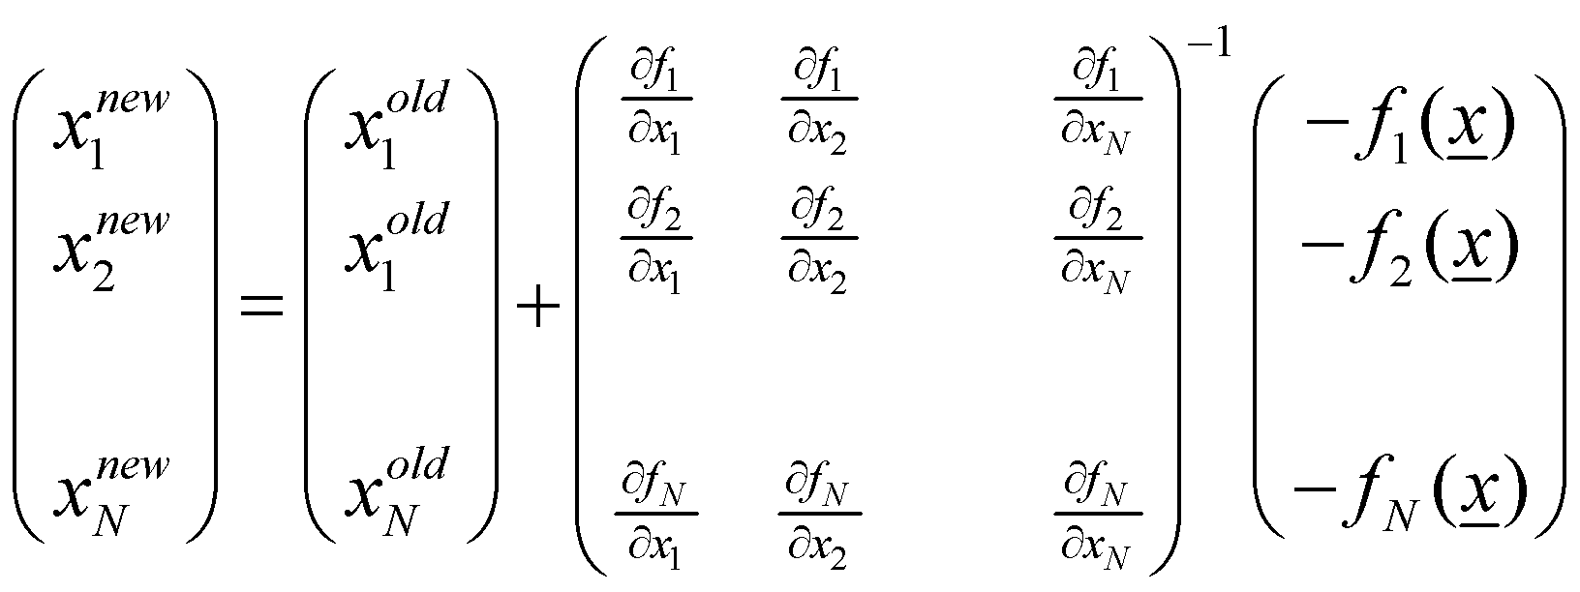
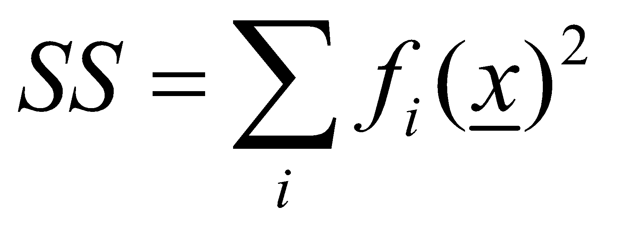
Multi-dimensional Newton-Raphson
Given a current vector x^{old}, it can be updated according to the equation:
Rather than attempting to solve the system of equations, it is often more efficient to apply an optimization method to minimize a quantity:

Slide 30
Optimization
Non-linear minimization (or optimization) is the numerical technique that is used by far most frequently in fisheries assessments.
Problem:
Find the vector θ so that the function f(θ) is minimized.
maximizing f(θ) is the same as minimizing -f(θ)
We may place bounds on the values for some of the elements of f(θ)
(e.g. some must be positive).

Slide 31
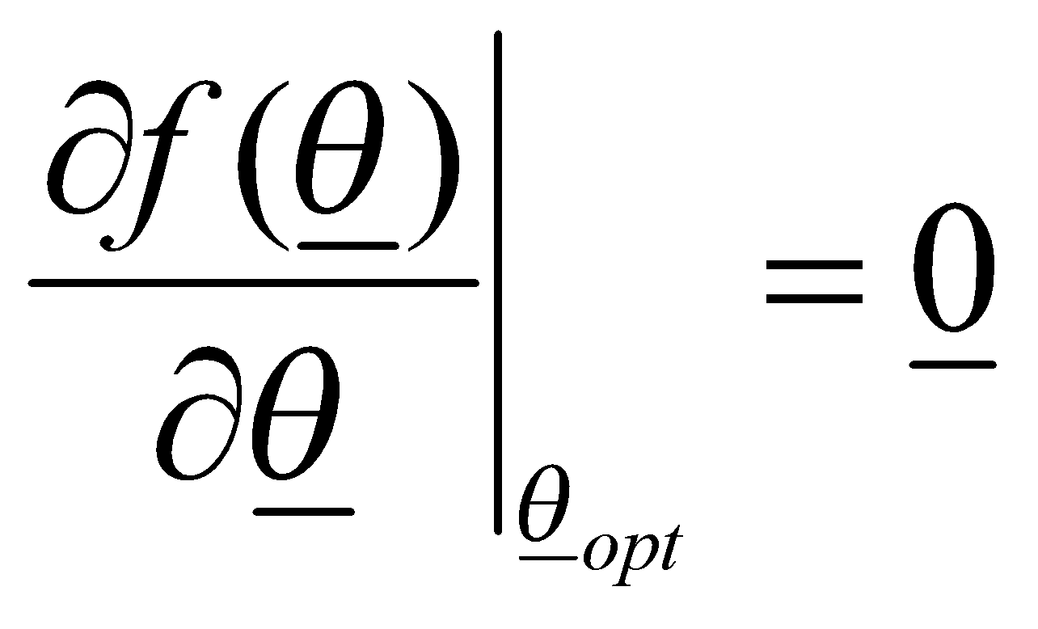
Minimizing a function
Optimization is similar to root-finding
By definition, for a minimum:
There is no perfect algorithm.
The art of non-linear minimization is to know which method to use & how to determine whether the method has converged to the correct solution.

Slide 32
Minimizing a function
Many techniques to find the minimum (maximum) of a function. Choice among these depends on:
Cost of evaluating the function;
Cost of programming;
Cost of storing intermediate results;
Whether analytical or numerical derivatives are available;
Whether bounds are placed on some of the parameters.

Slide 33
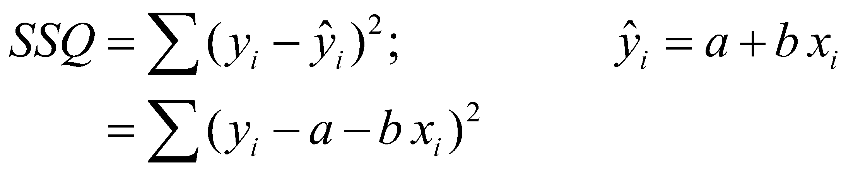
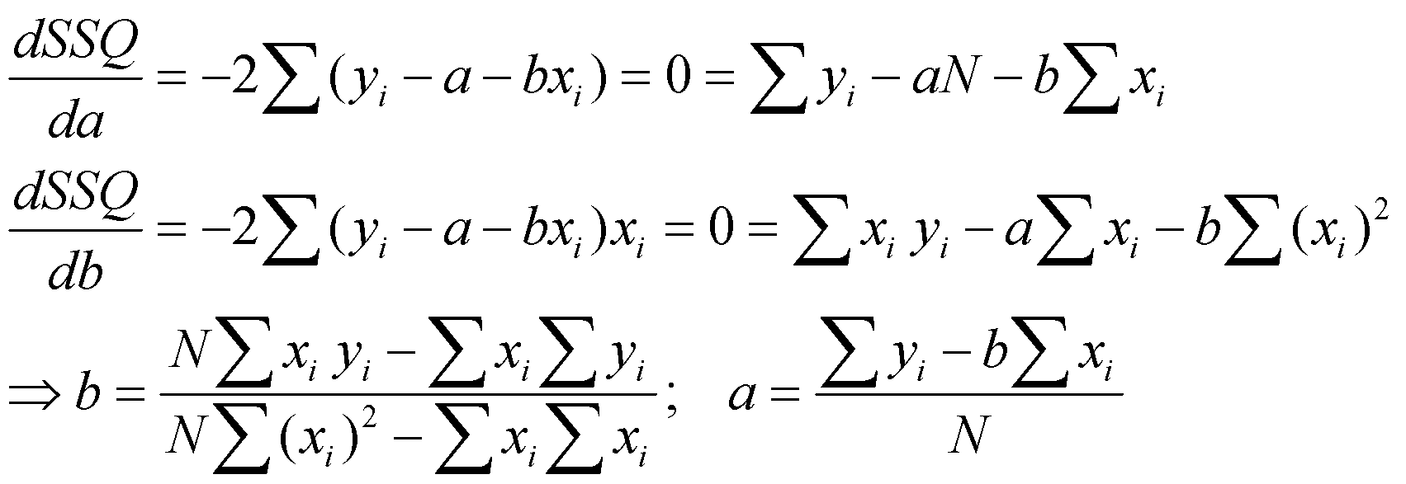
Analytic Approaches
Sometimes possible to solve things directly.
For example, linear regression:
Now:

Slide 34
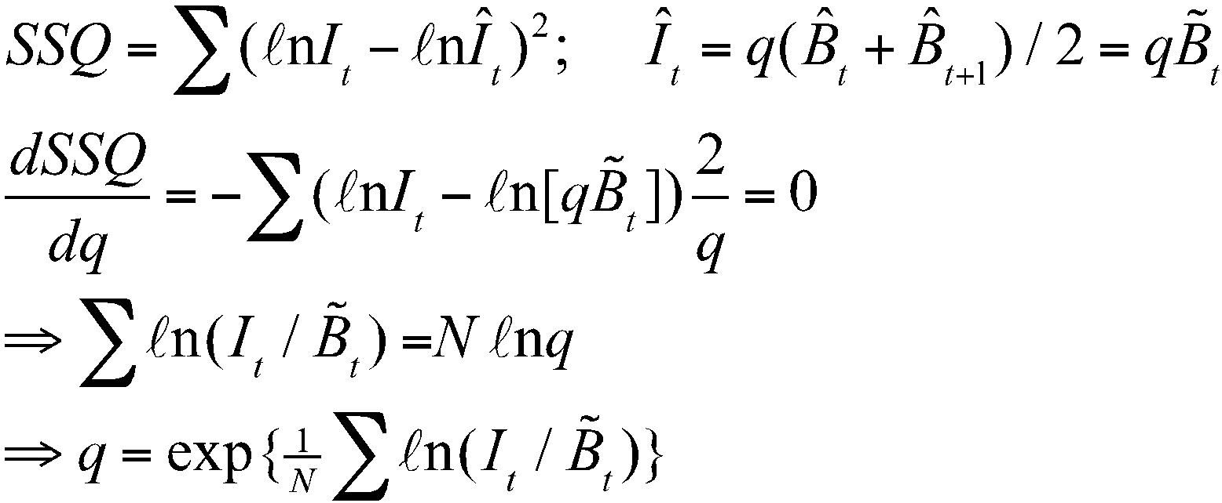
Analytic Approaches
Use analytical approaches when possible.
Finding analytical solutions for some parameters of a complicated model can speed up the process of minimizing the function.
For example: catchability (q) for the Dynamic Schaefer model:

Slide 35
Numerical approaches
The “analytical approach” has 2 main problems:
The differentiation is very complicated for typical fisheries models.
Some problems may not have an analytical solution.
Need to find numerical solution.
Two main classes of method:
Gradient based
Non gradient based

Slide 36
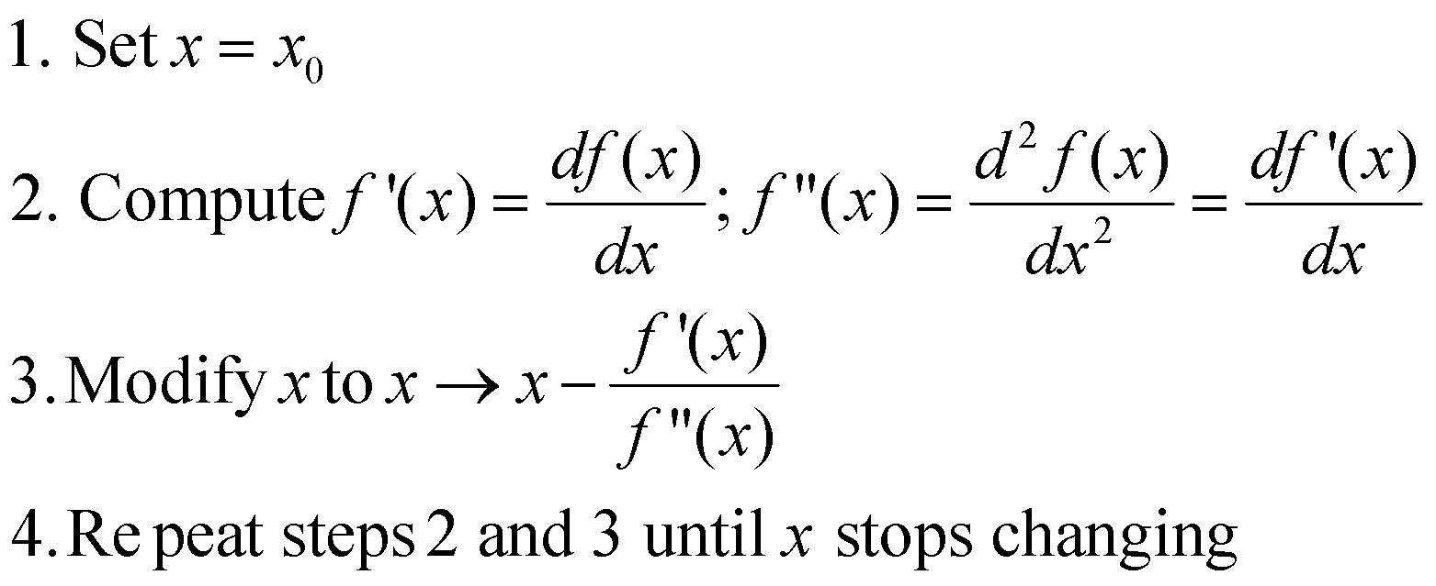
Newton’s Method (single variable version)
Same as for root-finding except we are interested in finding when f’(x) = 0 instead of f(x).

Slide 37
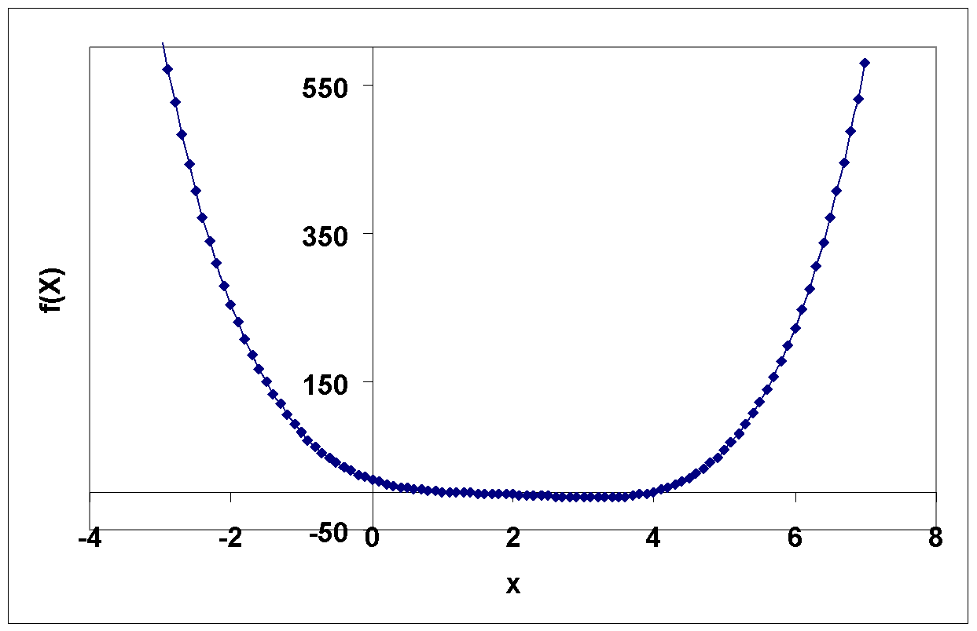
Minimize: 2+(x-2)^4-x^2
This is actually quite
a nasty function –
differentiate it and see!
Minimum: -6.175 at x = 3.165
Convergence took 17 steps in this case.

Slide 38
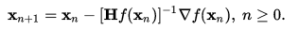
Multidimensional methods
Most fisheries problems are (highly) multidimensional.
Derivative free:
Nelder-Mead (Simplex);
Direction-set methods (Powell’s method).
Derivatives required:
Conjugate gradient methods (Fletcher’s method);
Quasi-Newton methods
The basic result that drives these methods is the Hessian matrix.
Computing the Hessian matrix can be very demanding computationally so these methods approximate it numerically
Usually no reason not to use derivative-based methods if you can compute derivatives (cheaply).

Slide 39
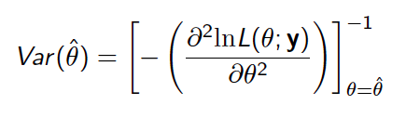
Calculating variance of estimates
Optimization routine provides us with the ‘best’ estimates.
Would like confidence intervals for parameters & derived variables (such as population size).
We can obtain variance estimates for parameters by inverting the Hessian.
How to obtain these for derived quantities?

Slide 40
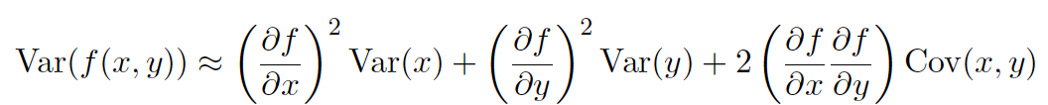
Delta method
The good news: ADMB & TMB will compute this for you automatically if you tell it to.

Slide 41
Fitting challenges
High-dimensional problems
Slow function evaluations
Use more efficient optimization method
Derive analytical expressions for parts
Rewrite code to compute objective function more efficiently, or implement in faster language
Allow lower tolerance for fits
Ask your advisor to buy you a faster computer
Discontinuities and thresholds
Multiple minima
Constraints
Add bounds to parameters [boundary issues]
Add penalties
Use transformations for parameters to avoid constraints

Slide 42
Troubleshooting
Understand the model you’re fitting
check starting conditions
check convergence conditions
adjust parscale/restart from previous best fit
switch from constraints to transformed parameters
adjust finite-difference tolerances (ndeps)
Results depend on starting conditions?
check slice between answers/around answers: multiple minima or just convergence problems?
Convergence problems: try restarting from previous stopping point, examine profile likelihoods.

Slide 43

Automatic Differentiation
Both symbolic & numerical differentiation have problems:
errors calculating higher derivatives
slow to compute partial derivatives of a function with respect to many inputs.
Automatic differentiation solves all of these problems (but we need different software).

